Slide 1

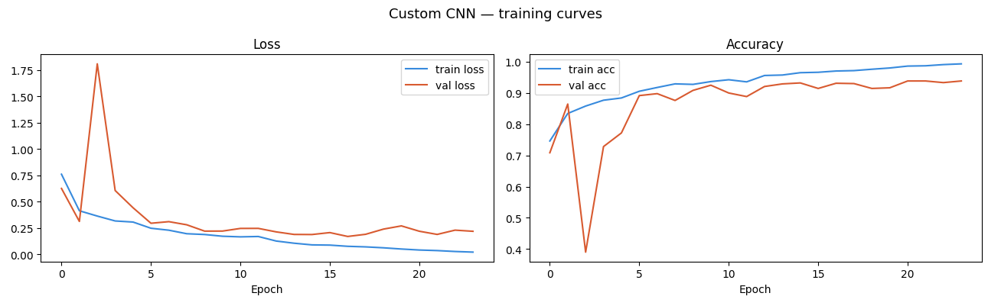
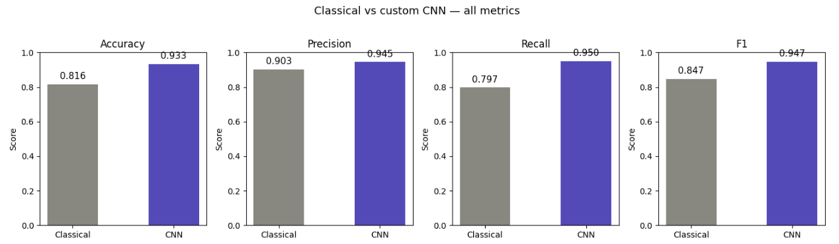
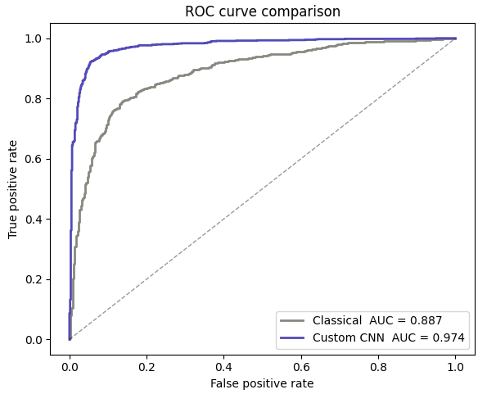
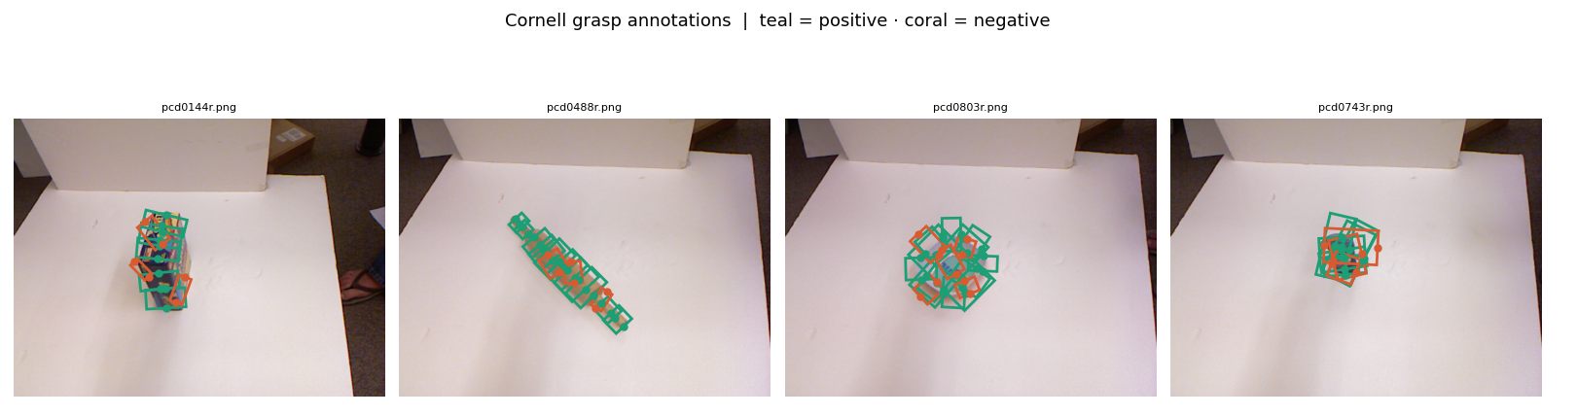
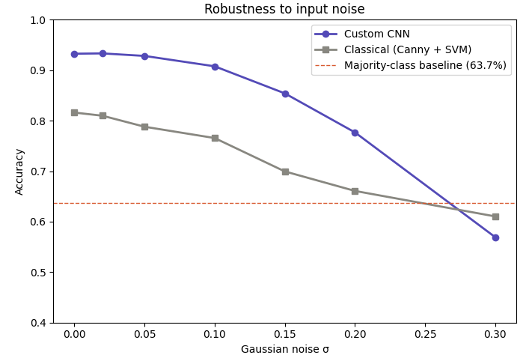
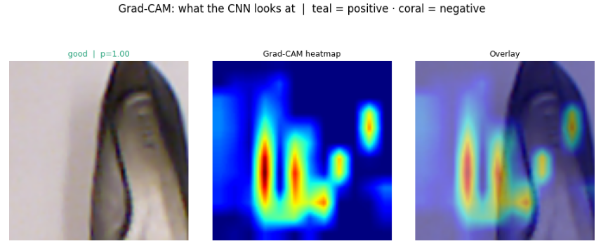
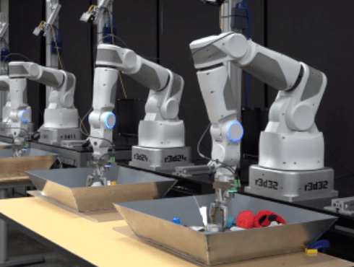
[Success/Failure Classification Model for Robotic Grasps Configurations]
[Aditya Ningaiah]
Applied Deep Learning for Engineering Mechanics
Class Project
Department of Mechanical and Aerospace Engineering, Rutgers University, Piscataway, New Jersey
Abstract
Materials and Methods
Results
Robotic grasping remains a challenging task in fields such as industrial and manufacturing automation. Classical approaches in order to solve this problem use contact mechanics theory such as force-closure and antipodal grasps which rely heavily on human-engineered features like object edges. While sound in theory, these approaches typically fail when confronted with real-world abnormalities or less-than-optimal images of the object. This project aims to address these gaps by building a robust computer vision CNN model capable of classifying 96 x 96 RGB image patches as either having viable or non-viable grasp configurations. Using the Cornell Grasp Dataset, a classical baseline will be developed along with a custom 4-block 2D CNN which is able to learn grasp features directly from the raw image pixels. These two approaches will then be evaluated against each other not only using standard metrics of performance but also with a Noise Robustness Test which will empirically demonstrate how the CNN outperforms the classical benchmark as image quality degrades.
Dataset and Setup
Dataset Used: Cornell Grasp Dataset
Physical Constraints: The gripper type is a parallel-jaw gripper that can not wrap around objects. The gripper is also assumed to always approach to the object perfectly top-down. The jaw plate is a 5-parameter rectangle model where height and width are constant.
Binary Classification: The model takes in a 96 x 96 x 3 RGB Image tensor. Robotic parameters such as target X/Y coords., wrist angle, and jaw width are encoded into the image patch through the preprocessing pipeline. The model then outputs a binary probability score (0 to 1), where 1 means that the geometric/spatial features within the patch indicate a successful grasp and vice versa.
Tools/libraries: OpenCV (Canny Edge Detection), TensorFlow, Scikit-Learn
Neural Network/ Model Architecture (if applicable)
Model type: CNN
Key hyperparameters: 4 Conv. Blocks, 0.5 dropout rate, 40 epochs, early stopping patience, learning rate schedule
Mechanistic priors or constraints if used: The classical baseline uses a Canny edge detection + classic SVM approach derived from rigid body physics. This assumes that a viable grasp must involve the robotic fingers clamping on opposing, physical boundaries. In the CNN pipeline, each image patch is mathematically cropped and rotated so that the robotic jaws are always perfectly horizontal, allowing a rigid spatial constraint to be enforced on the dataset.
Key Takeaways
Problem Definition
Classical methods such as Canny Edge Detection look at local pixel intensity where if a sharp color gradient exists, it marks it as an edge. The custom CNN however is able to learn shape context, understanding the relationship between empty space between the jaws, boundary of the object, and center of mass. This allows the CNN to have a strong resiliency to image and sensor noise, showing marked improvements in a metric where the classical methods tend to fail.
In robotic manipulation tasks, determining whether a grasp configuration is successful remains a critical challenge. In order for a robot to successfully pick up an object, it must identify viable contact points with the object from visual data. The classical approach to this problem heavily relies hand-crafted feature extractors, (i.e. Canny Edge Detection) which frequently fail when subjected to textureless surfaces, shadows, and noisy sensor data. A need for a more robust method for interpreting geometry and texture without relying on manually engineered features has risen as a result of this.
Future Direction and Applications
1st Conv. Block
48x48
32 filters * (5x5)
Regularization
MaxPooling + BatchNorm after every conv
The current model evaluates 3-DOF from a top down approach. The next progression of this model would be to incorporate depth data to allow for a 6-DOF grasp model, allowing the arm to approach the object at different angles and navigate complex geometries.
By connecting this model to real hardware, this model has potential to be applied to a variety of real-world industries such as moving towards fully automated warehouses and medical/surgical robotics.
Dense Head
256 neurons*ReLU, Dropout 0.5
Image Patch
(96 x 96 x 3)
2nd Conv. Blocks
24x24
64 filters * (3x3)
Flatten
9,216 units
Dense Head
128 neurons*ReLU, Dropout 0.3
3rd Conv. Blocks
12x12
128 filters * (3x3)
Output
Sigmoid, Success probability from 0-1
4th Conv. Blocks
6x6
256 filters * (3x3)
Acknowledgments
Training
Optimiser: Adam, lr =1e-3
LR Reduction: /2 after 3 plateus
Patience: 7 Epochs
Class Imbalance
OneOneLiu (2020). cornell_grasp. [online] Kaggle.com. Available at:
https://www.kaggle.com/datasets/oneoneliu/cornell-grasp.

